Slide 1
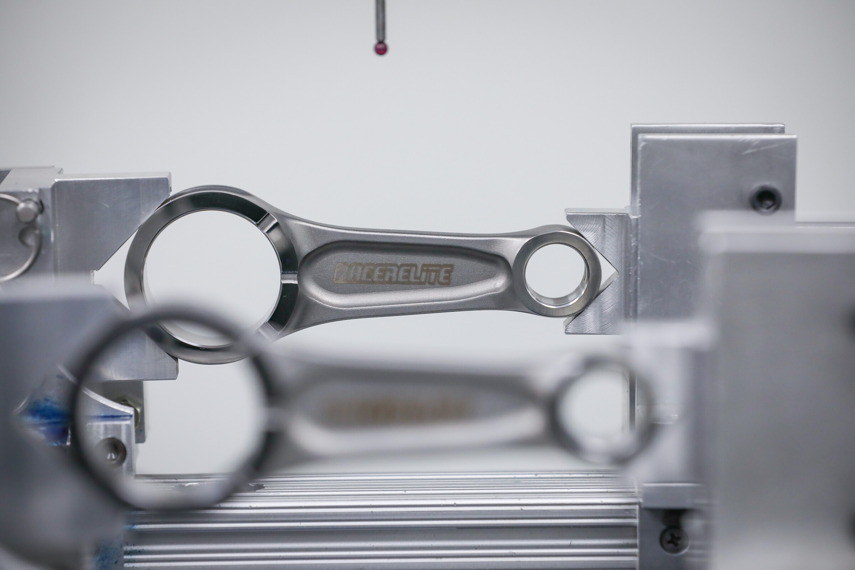


Visual Inspection of Motorcycle Connecting Rods
Giuseppe
Murro
91277 - Project Work in Image Processing and Computer Vision

Slide 2
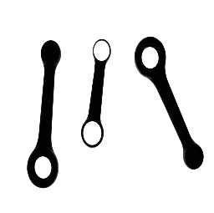

Project Goal
The project work goal is to develop a software system aimed at visual inspection of motorcycle connecting rods, calculating some useful information such as:
Type of the rod (A or B);
Position and orientation modulo $π$;
Length $L$, width $W$ and barycentric width $W_{b}$;
Position of the centre and diameter size of each hole.
2

Slide 3
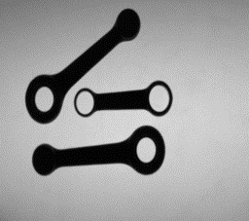
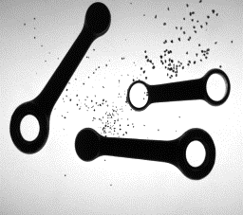
The Problem
Task 1
Images of connecting rods have been taken by the backlighting technique so to render rods easily distinguishable (i.e. much darker) from background.
Six images are provided, where the connecting rods appear well separated and do not contain any distracting elements.
Task 2
While still meeting the requirement of the First Task, the system is modified in order to deal with one or more changes in the characteristics of the working images.
The third set of images has been chosen for the extension, those in which inspection area may be dirty due to the presence of scattered iron powder
3

Slide 4
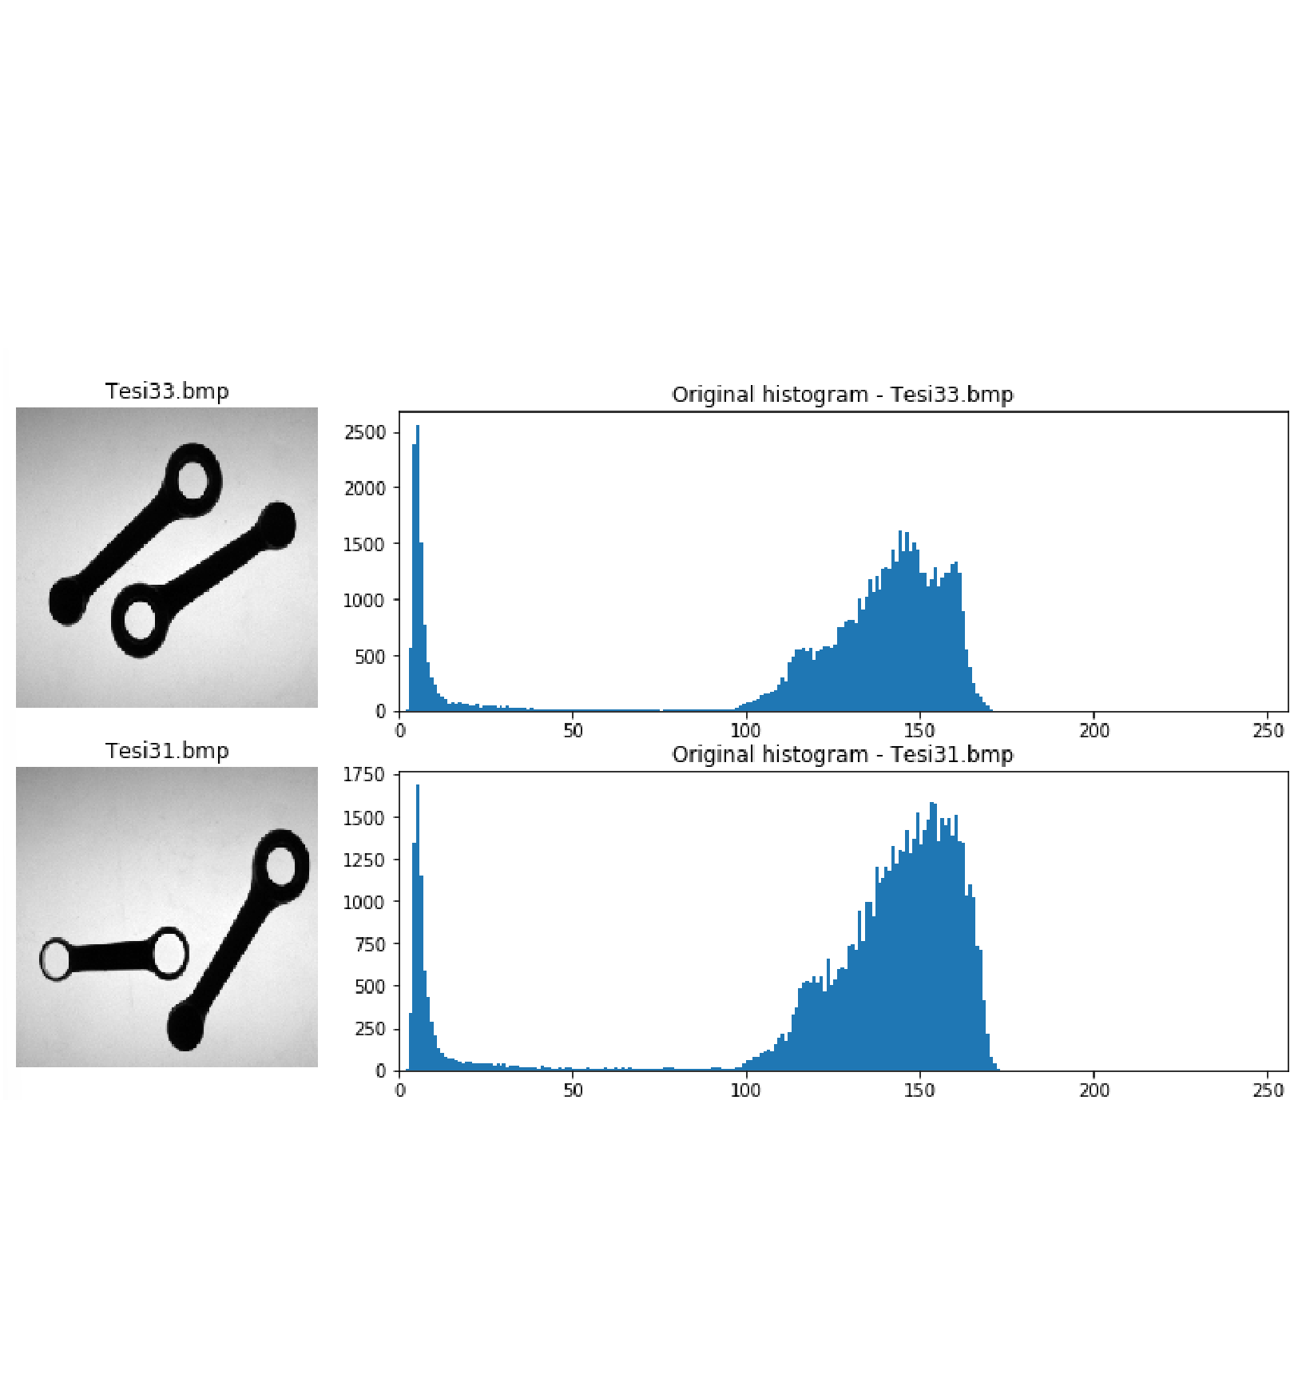
1. Histogram analysis
The first step is to analyse the histogram of the images.
The images are clearly bimodal, even if the peak of the second mode, corresponding to the background, is not very sharp due to light conditions
4

Slide 5
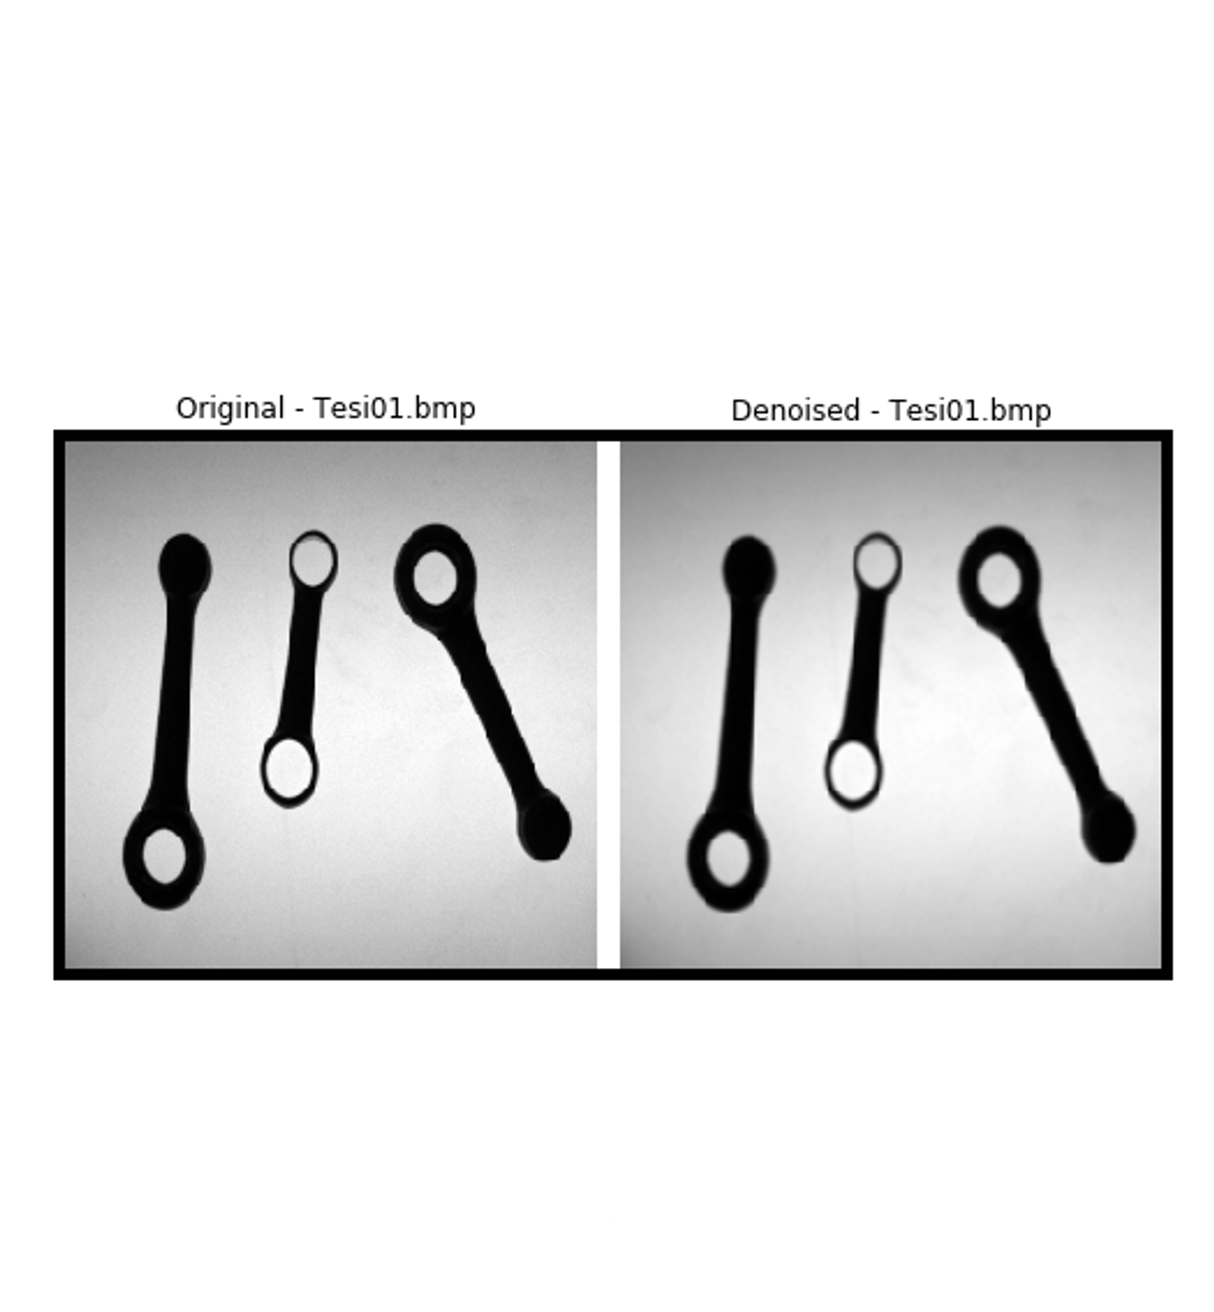
2. Denoising
The denoising process is performed using a Gaussian Filter with a kernel size of 3x3.
The smoothing process improved the histograms and allows for a more correct binarization.
5

Slide 6
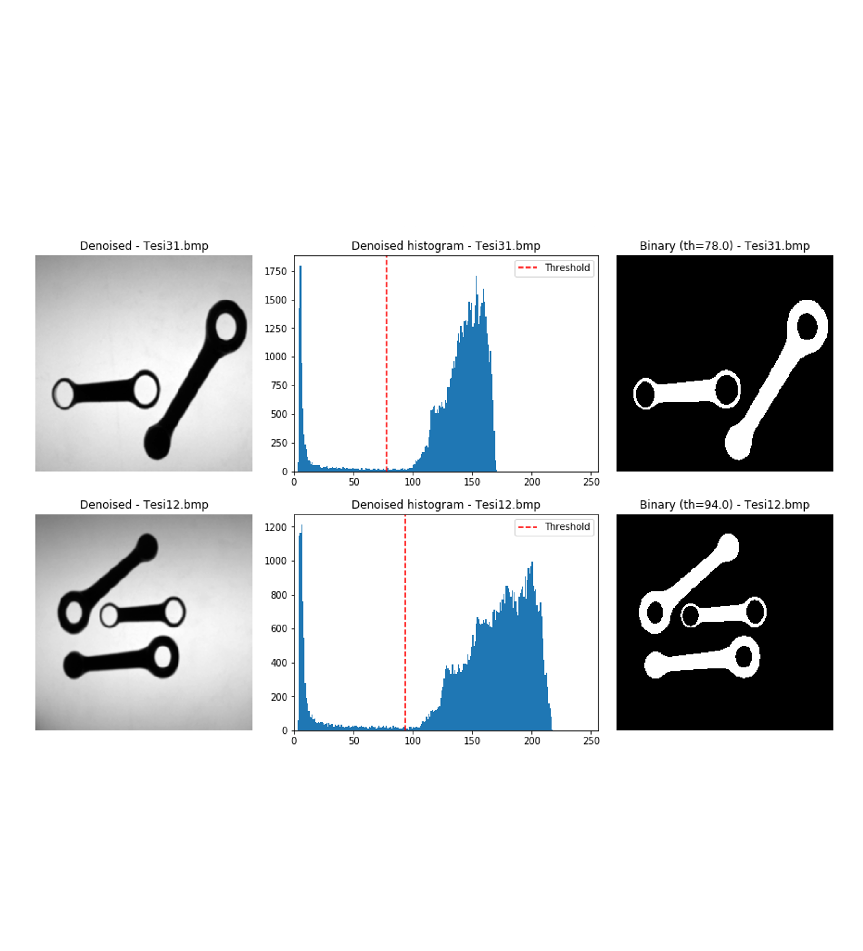
3. Segmentation
Since the images are bimodal, it is possible to perform a binary segmentation.
The binarization is performed using the Otsu’ Algorithm
6

Slide 7
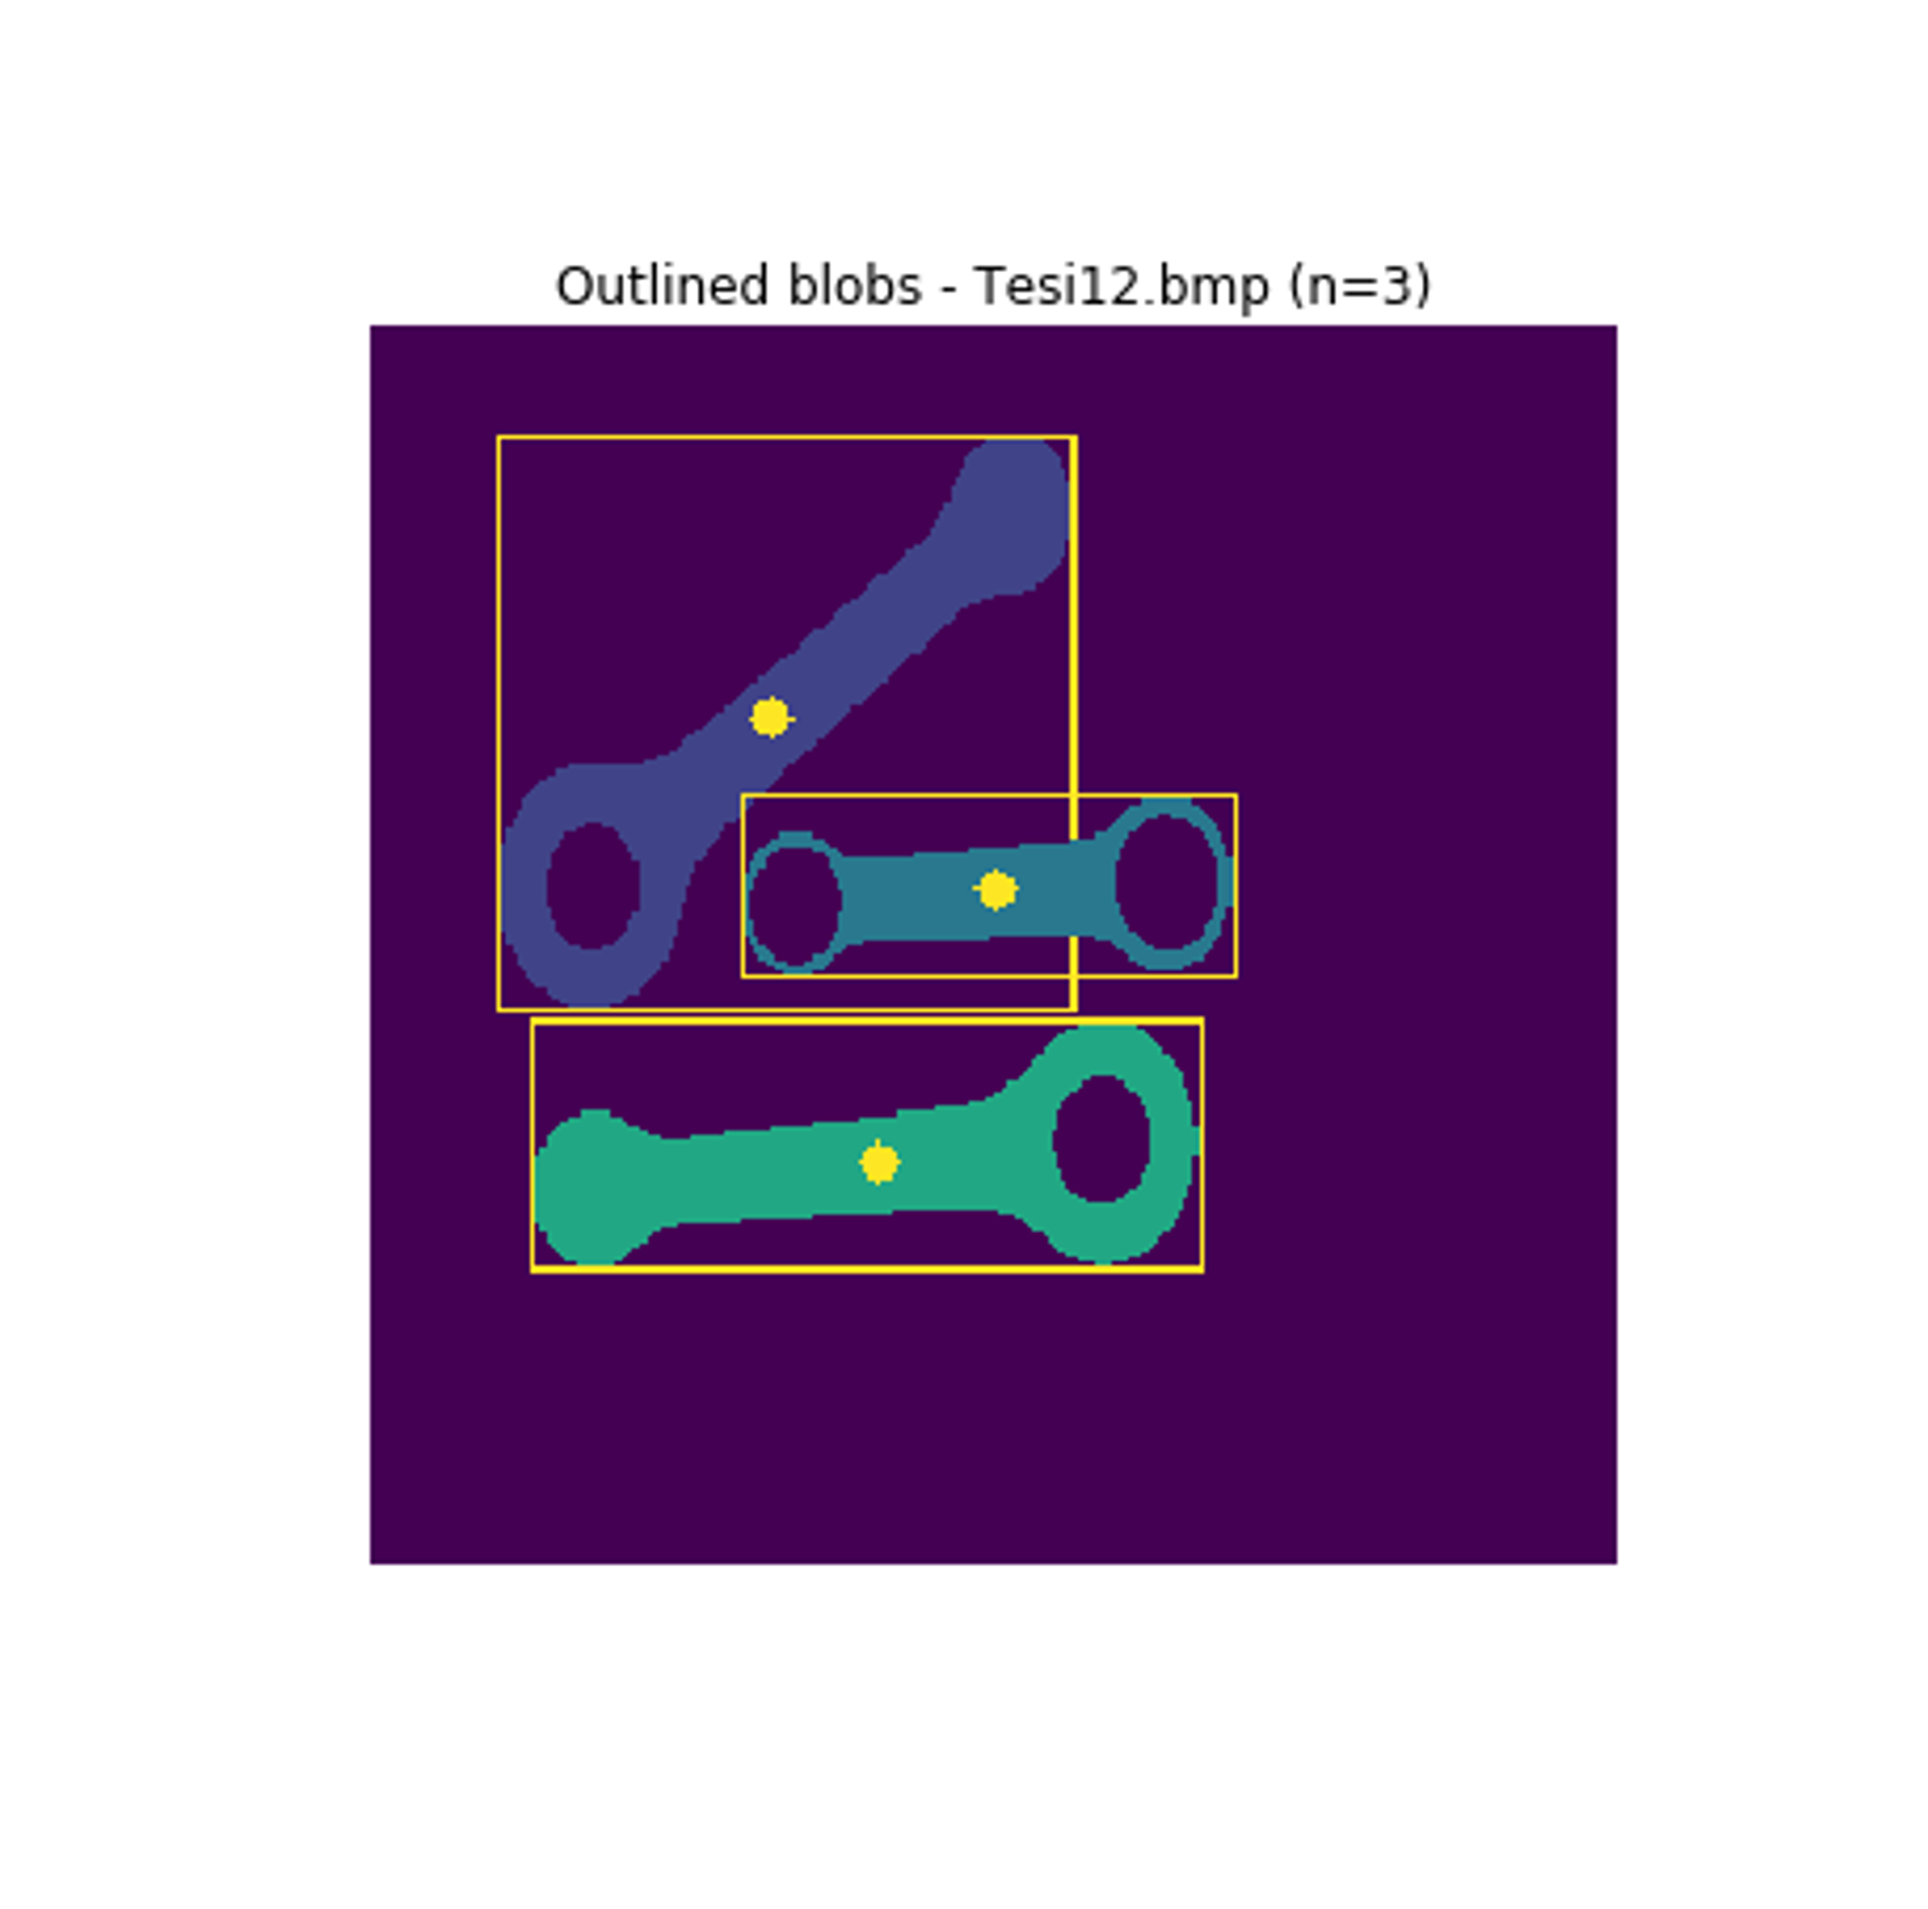
4. Connected component analysis
The foreground regions are further splitted into subregions where pixels belonging to different objects are assigned different labels.
This is done using the following function:
cv2.connectedComponentsWithStats()
7

Slide 8



5. Blob analysis
For each connecting rod appearing in the image, the system provides the following information
Type of rod
Hole stats
Rod position and dimensions
Orientation
Width at barycentre
Use function cv2.findContours()
to get contours of the foreground regions
1 hole → type A
2 holes → type B
Compute Haralick circularity to check that a contour refers to an hole (threshold = 6)
The diameter of the hole is computed as
The barycenter of the blob is computed using the moments:
The length and the width are computed using the function cv2.minAreaRect() applied to the blob contour
To compute θ, it is necessary to minimize the following function
The zeros of the first derivative are two, so an analysis of second derivative sign is needed to determine θ relative to major axis
Compute line parallel to the minor axis passing through the barycentre
The intersection between this line and the contour is given by the 2 points of the contour for which the distance from y_{c} to
m*x_{c}+q is minimal
8

Slide 9
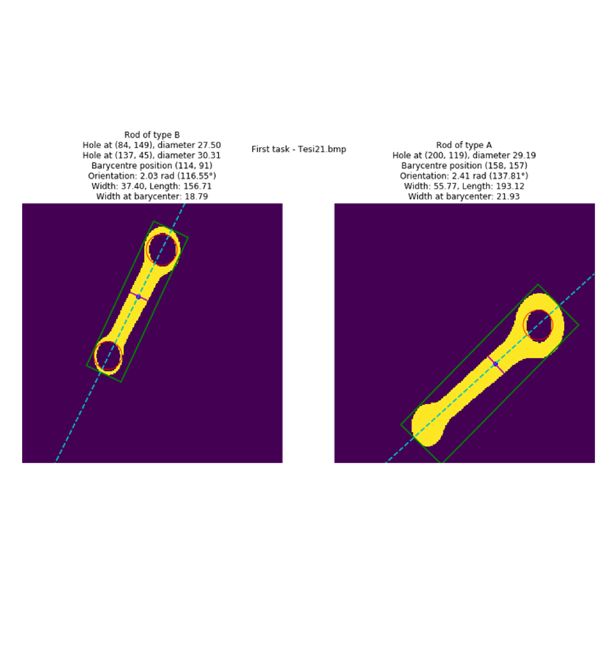
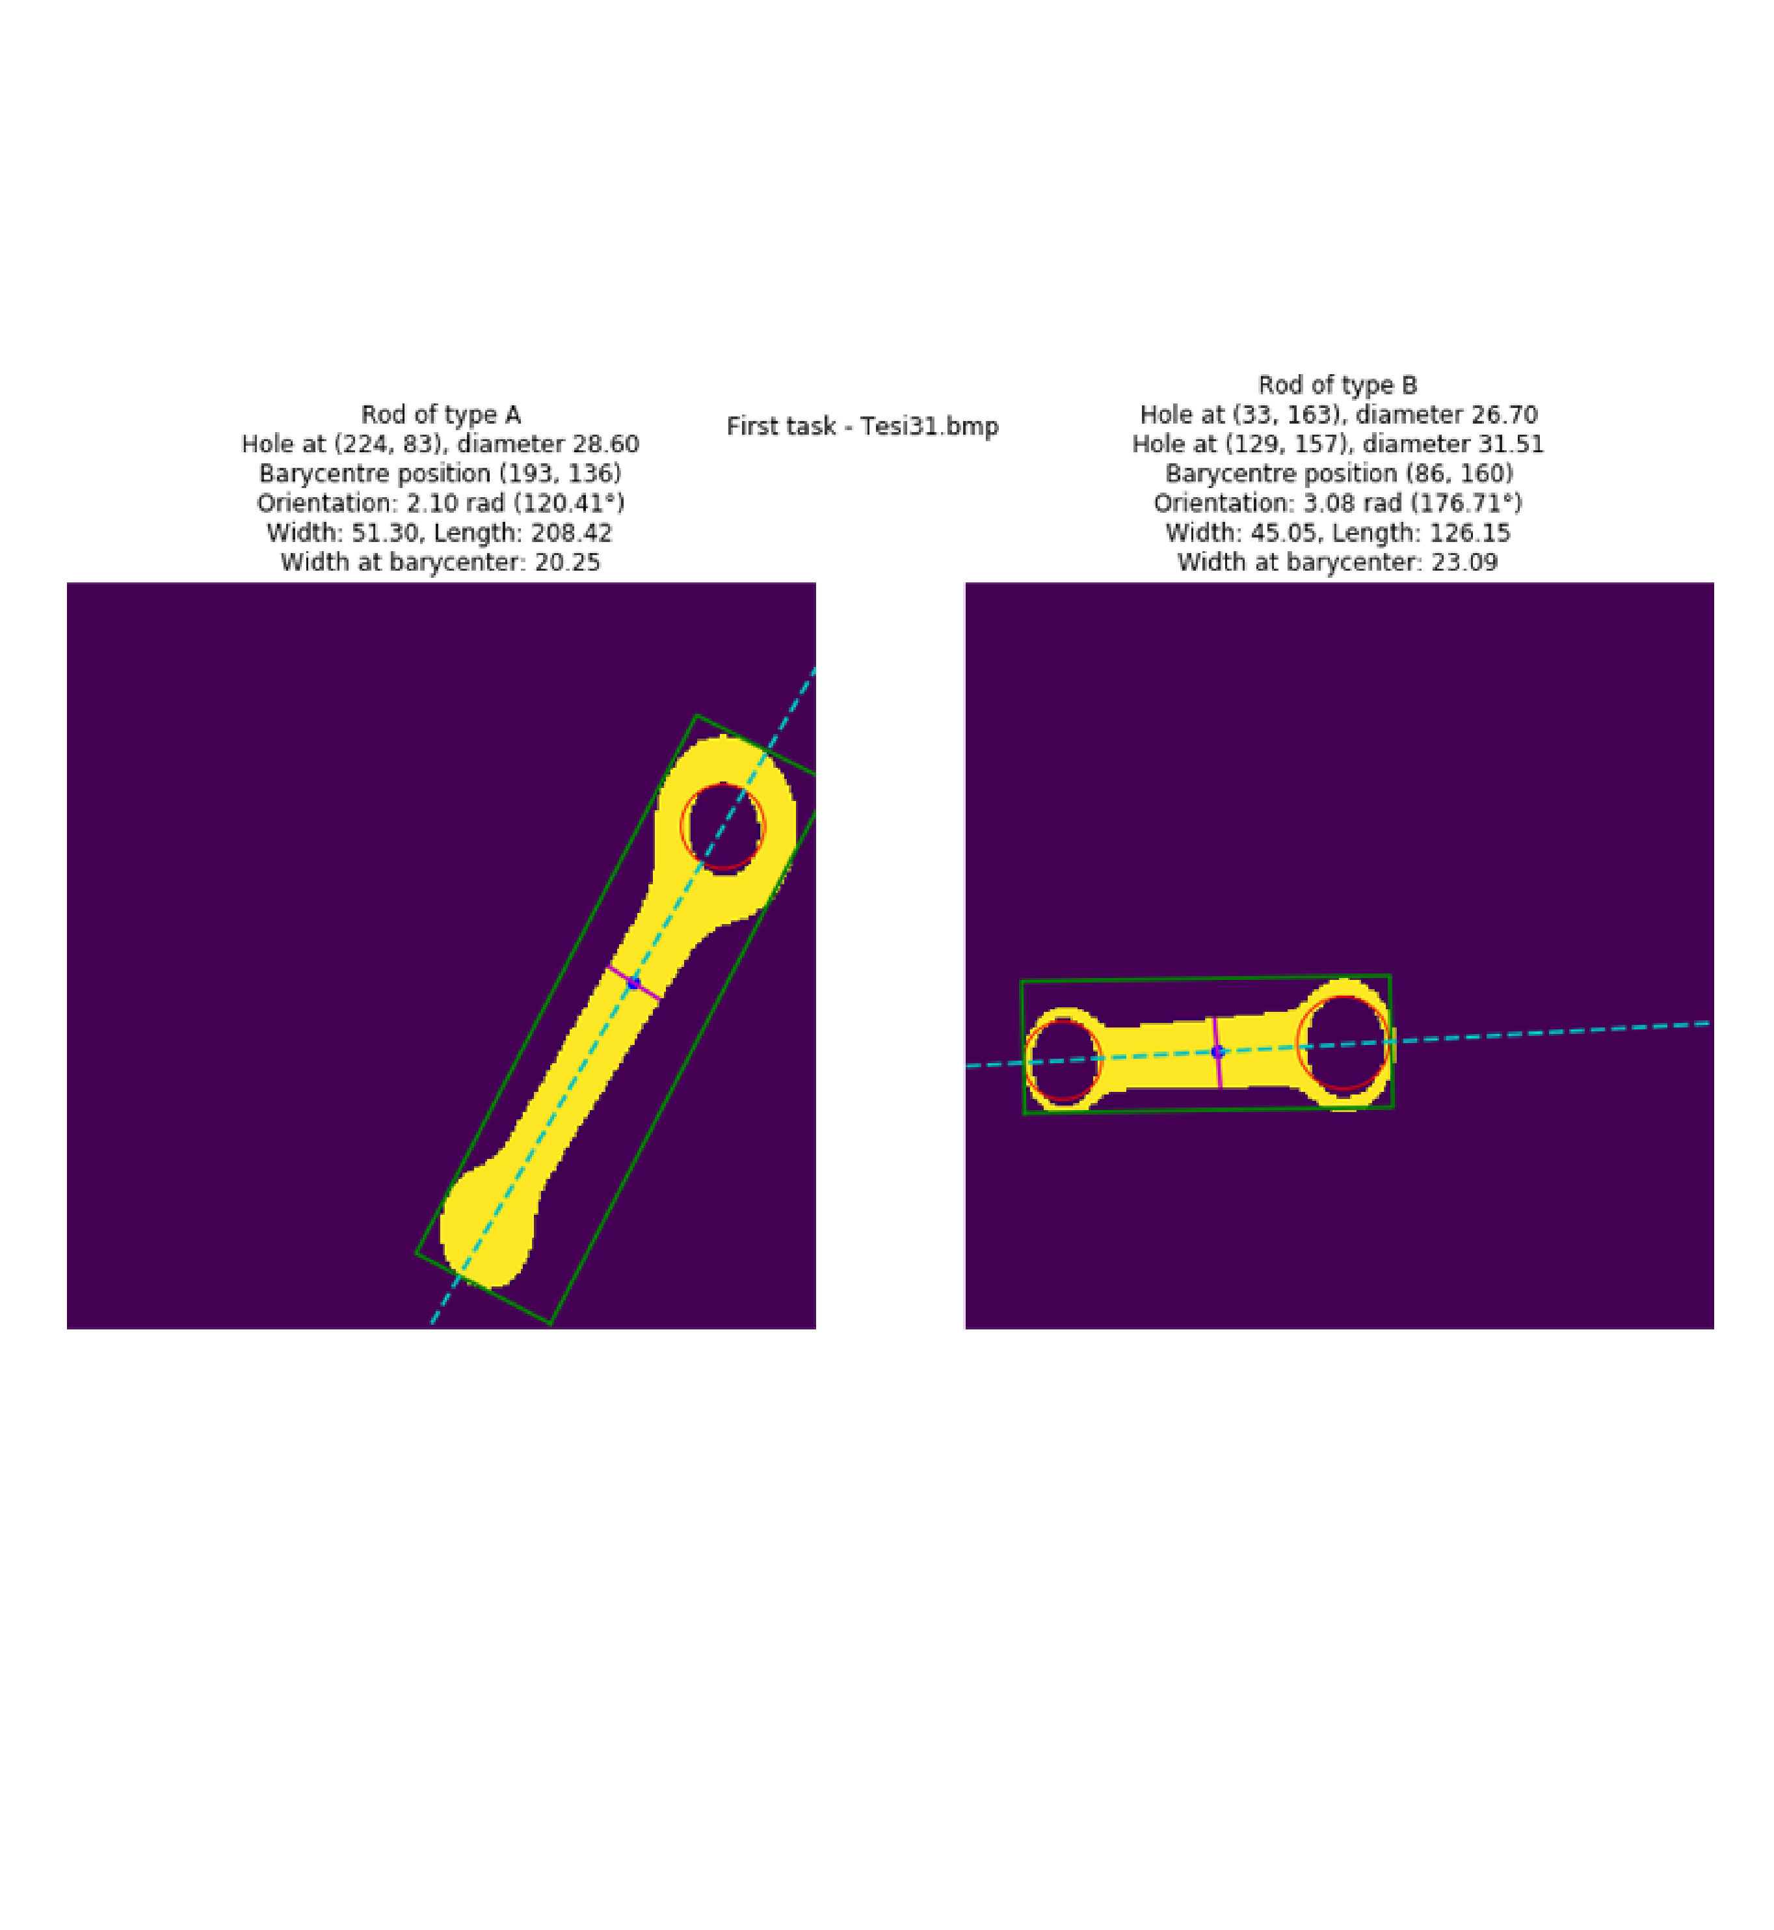
Task 1 - Results
All the resulted values are correct and are consistent with an human inspection.
9

Slide 10
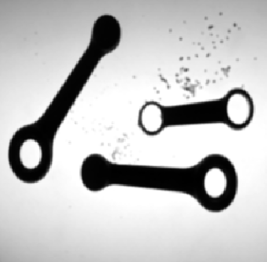
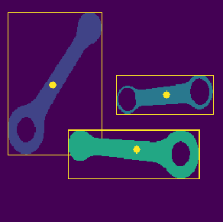
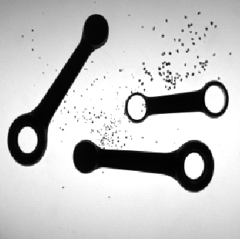

Task 2 – Complication resolution
Impulsive noise: images are corrupted by the presence of scattered iron powder (salt and pepper noise)
Filtered connected components → All the blobs with an area smaller than the minimum area (empirically set to 100) are discarded.
Denoising → Median filter with a kernel size of 3 is applied to the image before the Gaussian filter
Denoised – Tesi92.bmp
Blobs –
Tesi92.bmp
Original – Tesi92.bmp
Binary – Tesi92.bmp
10

Slide 11
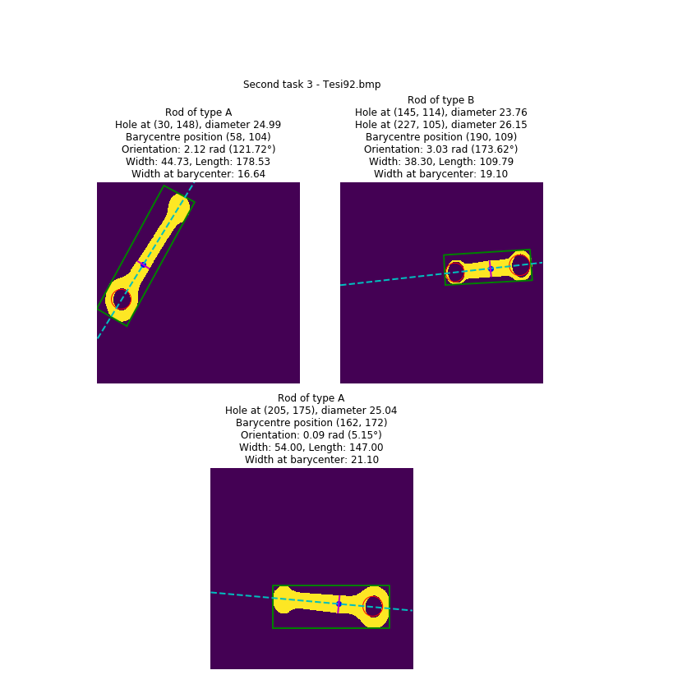
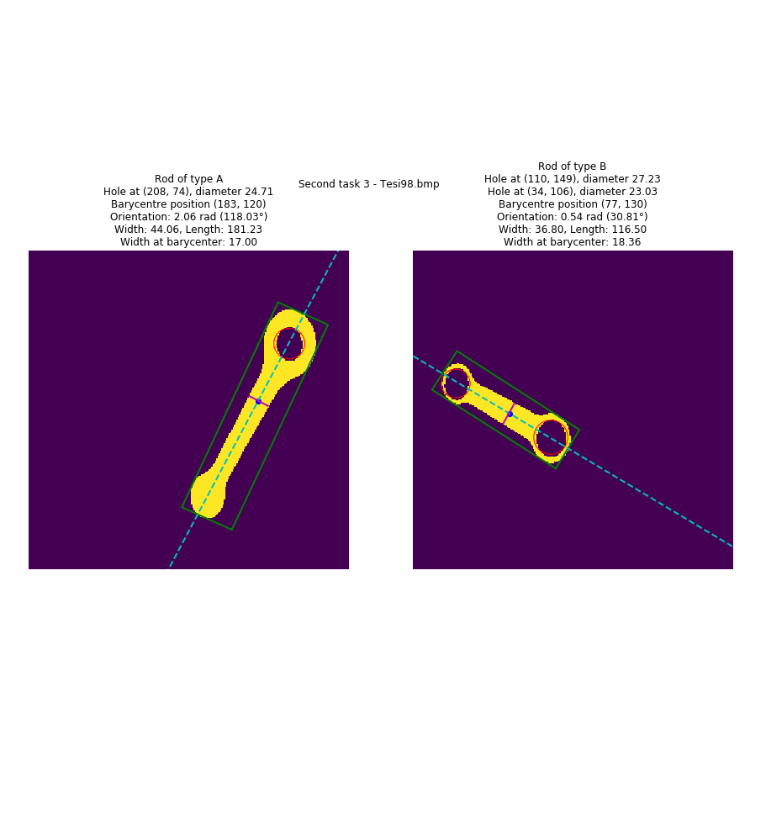
Task 2 - Results
A visual check of the results confirms that the inspection is correct.
11

Slide 12

Thanks for the attention
Giuseppe Murro
giuseppe.murro@studio.unibo.it
Student no. 997317

